Slide 1

NGA Geotagging Project Update Michael Kushla
2 July 2015
UNCLASSIFIED
1

Slide 2
Background
Sailing Directions—42 volumes.
Covers the world except for:
1. US territorial waters (Coast Pilot).
2. Black Sea.
3. Canadian Arctic.

Slide 3
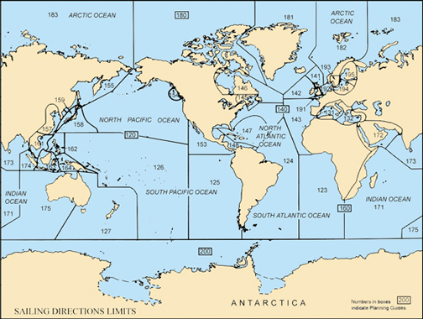

Slide 4
Process Flow
NGA provides Framemaker files to contractor.
Contractor creates new Framemaker Element titled Geotag with the following attributes and attribute values:
1. Coordinate String.
2. Geometry Type (point/line/polygon).
3. Maritime Type (including 98 sub-attributes).
4. Feature ID (contractor created).
5. Source Type (where information came from—light list, publication, DNC, ECR).

Slide 5
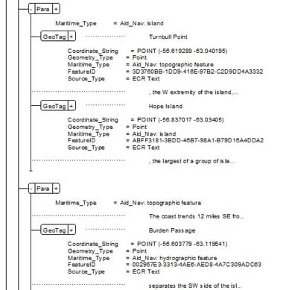
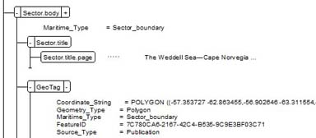

Slide 6
Process Flow (continued)
Contractor has 30 days to create shape files based on Geometry Type for each Maritime Type and to initially geotag the publication.
NGA has 60 days to complete the initial review of the publication.
Simple corrections can be made by NGA; more complex changes are referred back to the contractor for correction.
Contractor has 30 days to make changes.

Slide 7
Process Flow (continued)
NGA has 14 days to review the resubmitted publications.
NGA either accepts or rejects the publication.
Geotagging all publications is scheduled to be completed by the contractor by 30 September 2015.

Slide 8
Status as of 10 June 2015
Publications accepted by NGA—12.
Publications in geotagging process—3.
Publications in NGA review process—7.
Shapefile breakdown (based on five publications):
1. Points: 98.60%
2. Polygons: 1.33%
3. Lines: 0.07%

Slide 9
Future Plans
Ability to edit existing geotags and add new geotags to the database.
Output options in XML:
Allows for commercial industry product development.
Allows for easier updating methods (ie updating XML vs PDF).
Ability for the customer to search for and extract the exact Navigation Information for their needs.
Provided shape files enable customer to spatially view publication information outside the ECDIS platform.

Slide 10

UNCLASSIFIED
10
UNCLASSIFIED

